Slide 1
A* Pathfinding
Presented by :- alok kumar Singh
aman nayak ansh raj

Slide 2
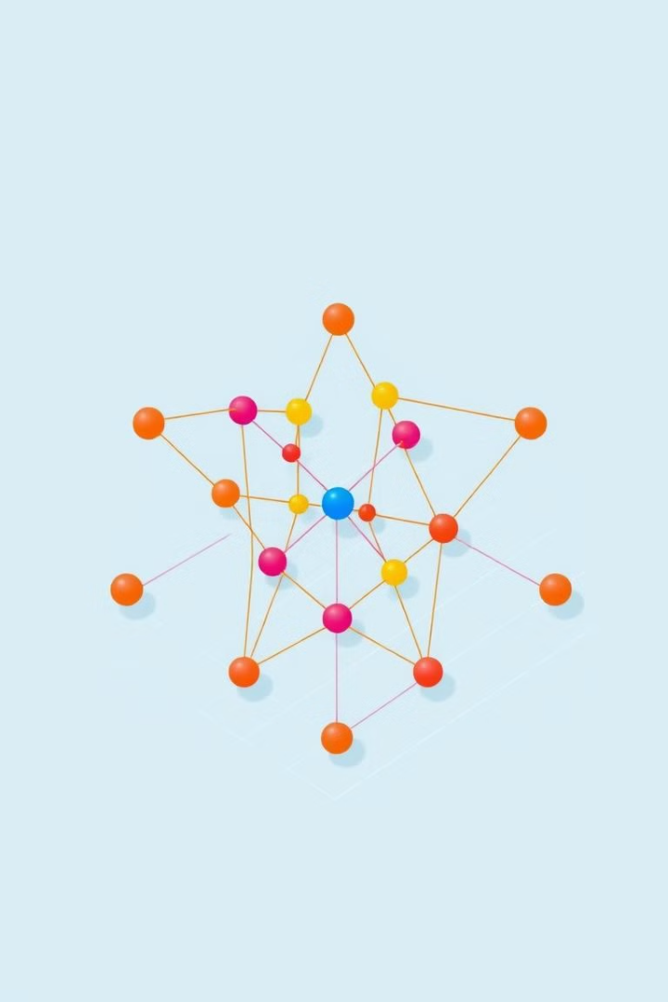
# Introduction to A* Pathfinding
Pathfinding finds the shortest route between points. Common uses include games, robotics, and logistics. The A* algorithm is defined by its goal to find the most efficient and optimal paths. Its popularity stems from its efficiency and optimality.

Slide 3
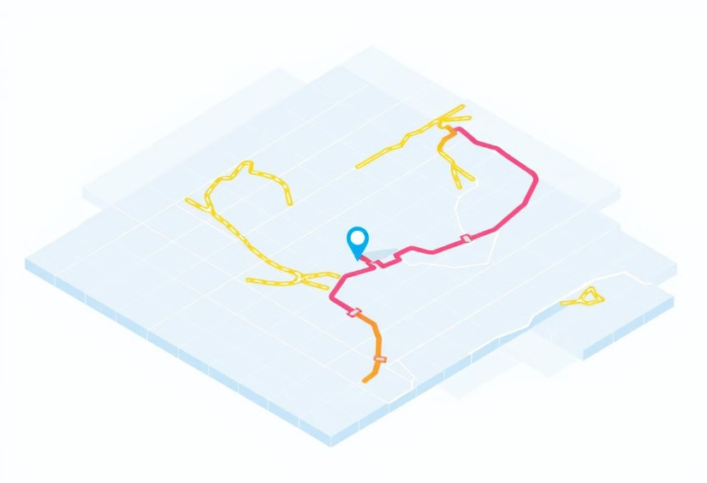
Core Components: Grid Representation
The environment is represented as nodes and edges in a grid. Cost values are assigned to different paths. Values represent aspects such as distance and difficulty. Heuristics estimate the cost to the goal.

Slide 4
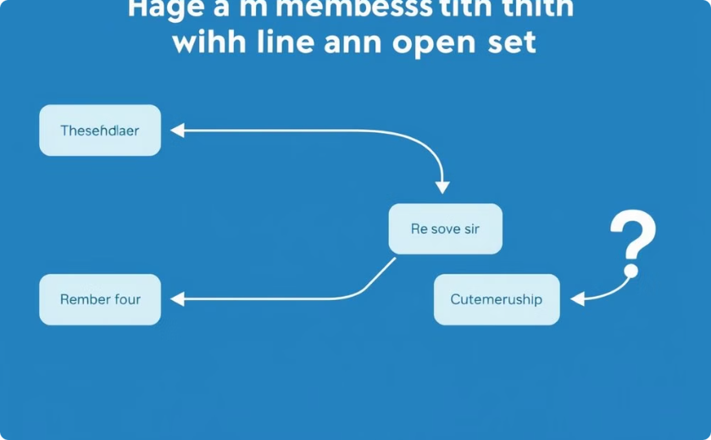
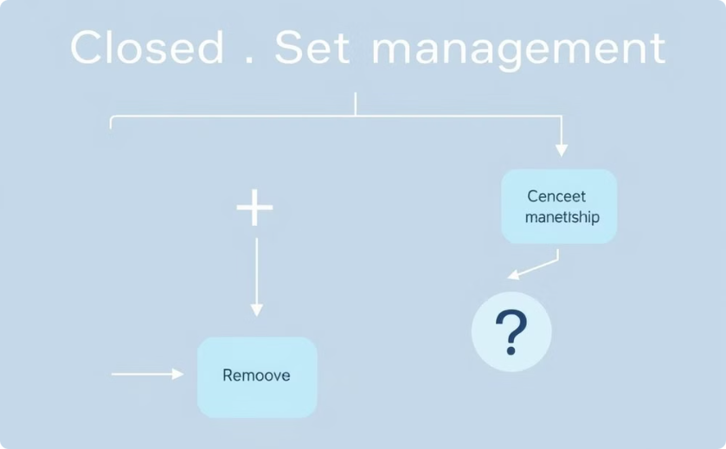
Core Components: Open and Closed Sets
Open Set
Closed Set
Nodes to be evaluated are kept in an open set. This is usually implemented as a priority queue.
Nodes already evaluated are placed in a closed set. Sets are managed by adding, removing, and checking membership.

Slide 5
A* Algorithm: Step-by-Step Example
Initialize the grid with start, goal, and obstacles.
Calculate f(n) for neighbors of the start node.
Select the node with the lowest f(n) from the open set.
Move the selected node to the closed set.
Repeat until goal reached or no path exists.

Slide 6
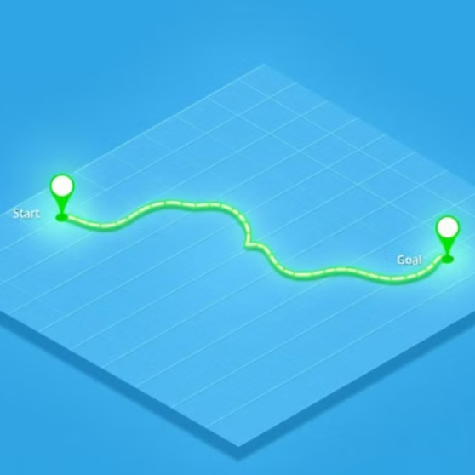
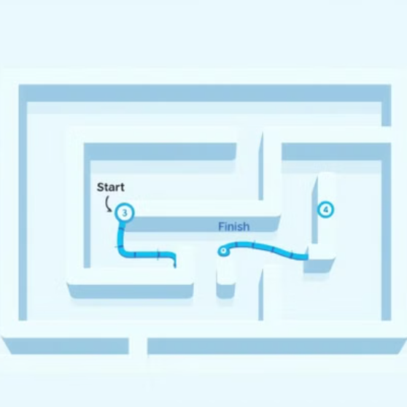
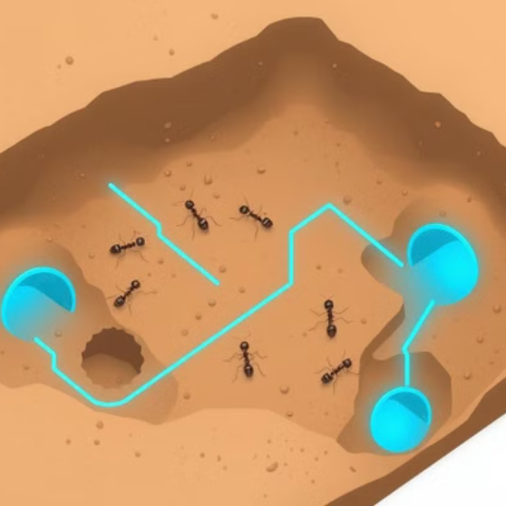
Detailed Example: Visualizing the Search

Slide 7
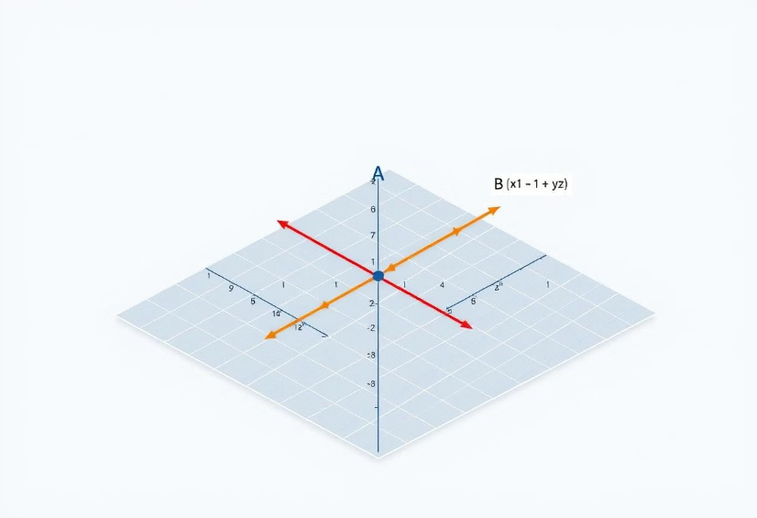
Heuristic Functions: Manhattan Distance
Calculate Manhattan distance using the formula: |x1 - x2| + |y1 - y2|. An admissible heuristic never overestimates the cost. Consistency means the heuristic satisfies the triangle inequality.

Slide 8
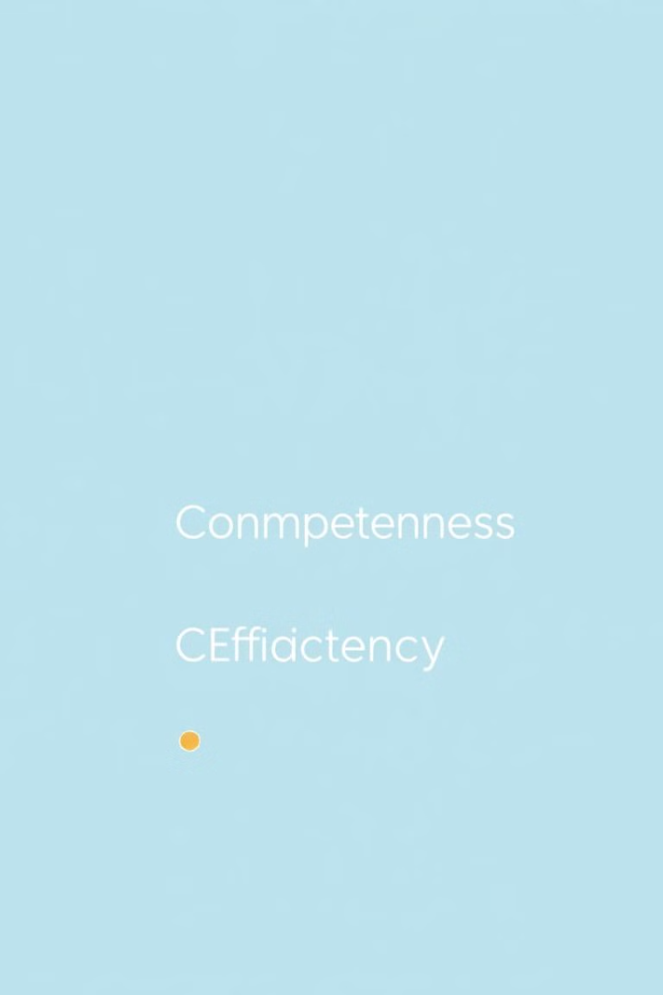
Advantages of A*
Completeness: Guarantees a path if one exists.
Optimality: Finds the lowest cost path.
Efficiency: Explores fewer nodes vs uninformed search.

Slide 9
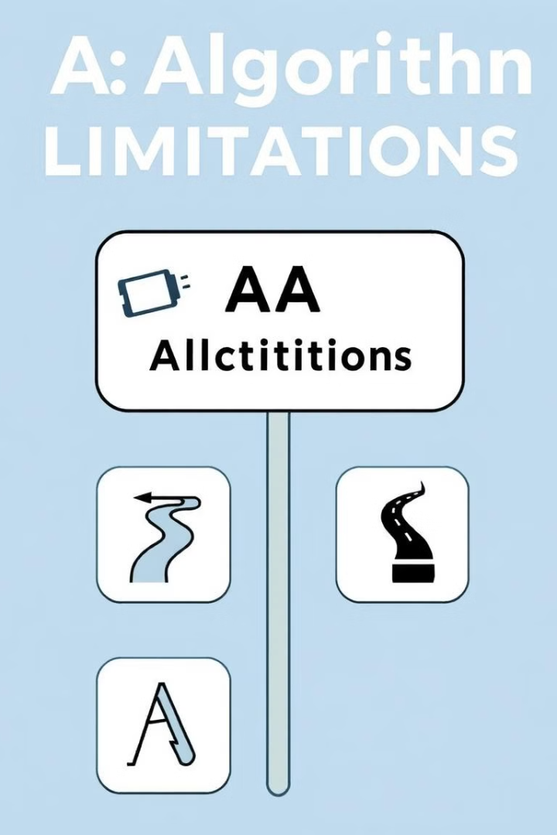
Disadvantages and Limitations
Memory consumption can be high with large open and closed sets.
Performance depends on the accuracy of the heuristic design.
May result in suboptimal paths if the heuristic is inadmissible.

Slide 10

Conclusion and Further Exploration
The A* algorithm is defined by its key features, including optimality and completeness. Explore books, articles, and online courses for more learning. Investigate variations and optimizations of A*.

